Slide 1
Module 2 - Arrays

Slide 2
Array
Memory that holds values of the same data type.
Elements of memory are accessed by Index position.
Index starts from 0.
Java does not support negative indexing or slicing.
Single or multidimensional array size.

Slide 3
Creating array
Declaring an array
String cars [];
Declaring an array with values
String cars [] = {"Volvo", "BMW", "Ford", "Mazda"};
int Num [] = {10, 20, 30, 40}

Slide 4
Accessing the elements of an array
String[] cars = {"Volvo", "BMW", "Ford", "Mazda"};
System.out.println(cars[0]);
// Output
Volvo
System.out.println(cars[2]);
// Output
Ford

Slide 5
Changing an element in the array
String cars [ ] = {"Volvo", "BMW", "Ford", "Mazda"};
cars[0] = "Opel";
System.out.println(cars[0]);
Output:
Opel

Slide 6
Length of array
String cars[ ] = {"Volvo", "BMW", "Ford", "Mazda"};
System.out.println(cars.length);
// Outputs 4

Slide 7
Example 1: Specific City Pincode
public class onedarray
{
public static void main(String arg[])
{
String city[] = {"Chennai","Delhi","Bangaluru","Hyderabad", "Mumbai"};
int pincode[] = {600001, 110001, 560001, 500001, 400001};
System.out.println(city[2] + " Pincode is " + pincode[2]);
}
}
Bangaluru Pincode is 560001

Slide 8
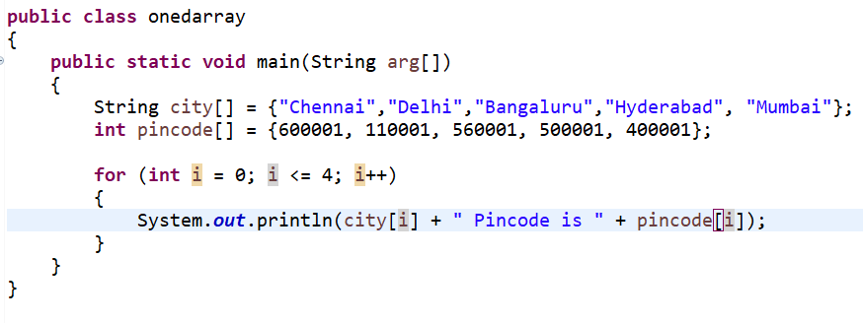
Example 2: Cities Pincode – using for loop
Chennai Pincode is 600001
Delhi Pincode is 110001
Bangaluru Pincode is 560001
Hyderabad Pincode is 500001
Mumbai Pincode is 400001

Slide 9
Memory Allocation using ‘new’
Syntax:
data_type identifier [ ] = new data_type [ array_size ];

Slide 10
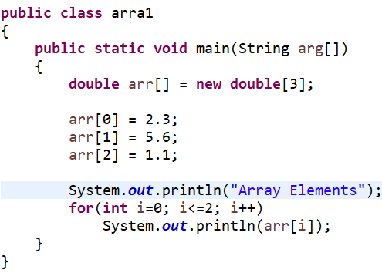
Array – ‘new’
Array Elements
2.3
5.6
1.1

Slide 11
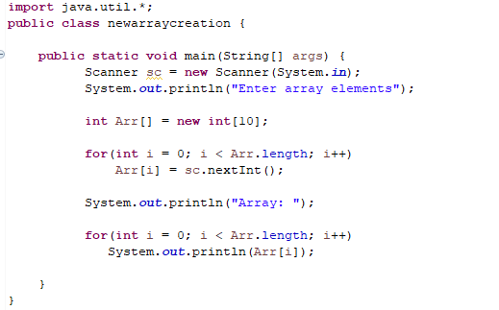
Creating Array and adding elements

Slide 12
TRY
TASK
Write a java program to print the sum of the elements present in an array.
Write a java program to print the minimum element value present in an array.

Slide 13
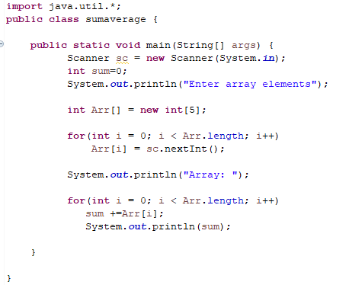
Solution - Sum

Slide 14
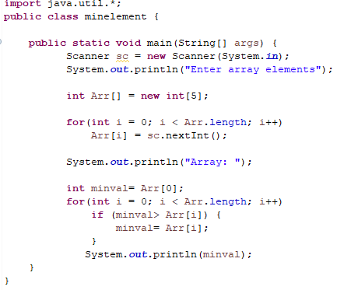
Solution - Min

Slide 15
Practice Problems
TASK
Write a java program to accept elements to an array and print only the even numbers in the array.
Write a java program to accept elements to an array and print the sum of the even numbers in the array.
Write a java program to accept elements to an array and print the cube of the values.
Write a java program to accept elements to an array and create a new array with the cube values.
Write a java program to accept roll numbers and marks in 3 subjects for 5 students. Print the roll number, total marks and average for each student.

Slide 16
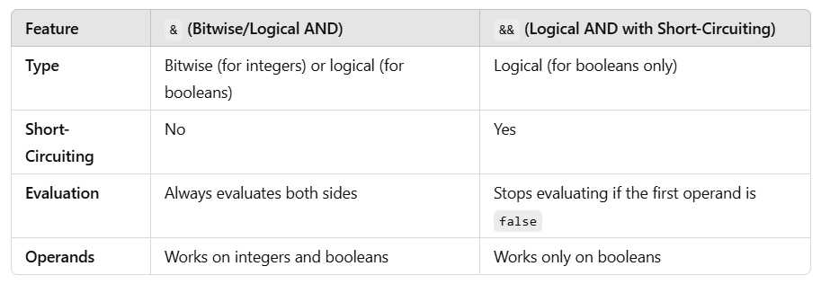

Slide 17
Feature | | (Bitwise/Logical OR) | || (Logical OR with Short-Circuiting)
Type | Bitwise (for integers) or logical (for booleans) | Logical (for booleans only)
Short-Circuiting | No | Yes
Evaluation | Always evaluates both sides | Stops evaluating if the first operand is true
Operands | Works on integers and Booleans | Works only on Booleans

